Slide 1

CLINIX HEALTH INFORMATION SYSTEM:
A Django & React Solution for Healthcare Management
●​ Author: Shaun Saisi
●​ GitHub Link: https://github.com/shaun-saisi/Clinix
●​ Live Demo: http://143.198.21.25/

Slide 2
●​ Objective:
Build a system for doctors to manage clients and health programs.
●​ Key Features:
Create health programs (TB, Malaria, HIV).
​ Register clients.
Enroll clients in programs.
​ Search clients.
​ View client profiles.
​ Expose client data via API.

Slide 3
●​ Tech Stack:
Frontend: React.js
Backend: Django REST Framework
Database: SQLite

Slide 4
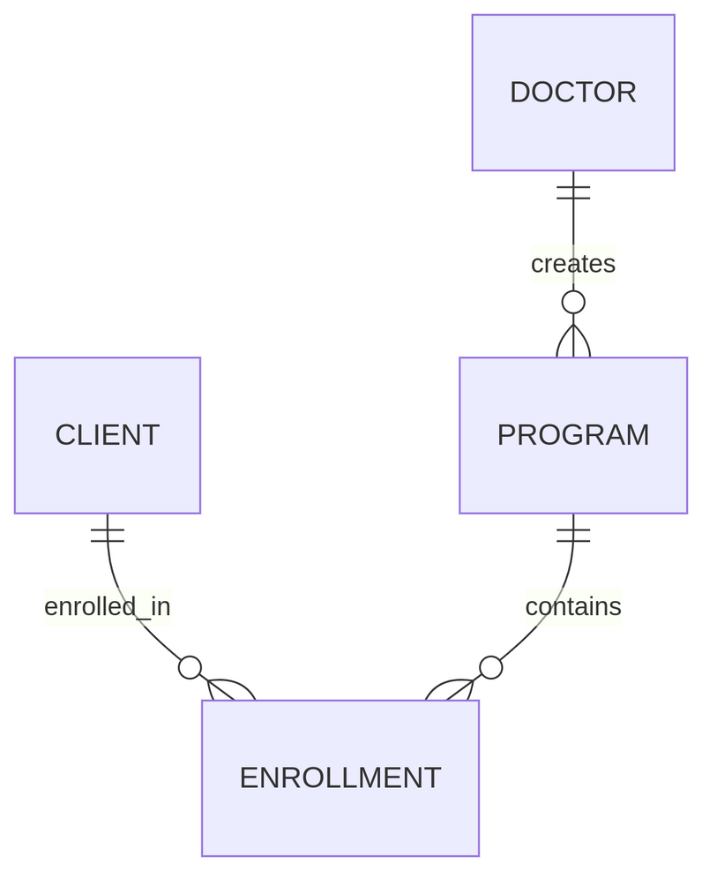
Entity Relationship Diagram (ERD):

Slide 5
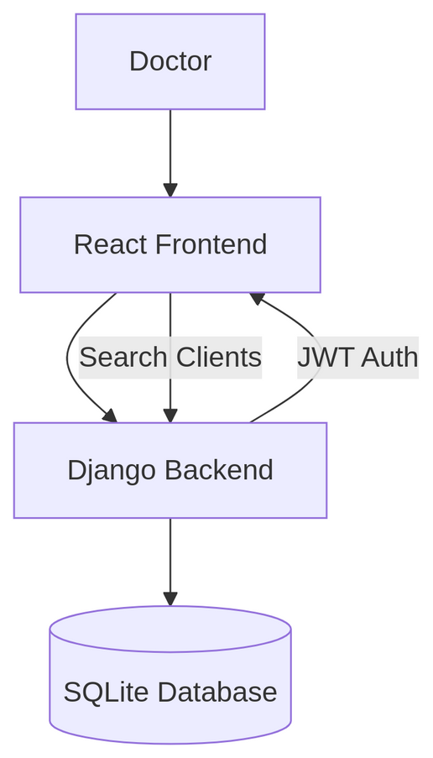
Data Flow Diagram (DFD):

Slide 6
Tables:
Doctor: Manages programs.
​ Client: Stores patient data.
Program: Health programs (e.g., TB, HIV).
​ Enrollment: Links clients to programs.

Slide 7
API-First Approach:
All features built as REST endpoints first.

Slide 8
Frontend Integration:
React components for forms and tables.
Axios for API calls.

Slide 9
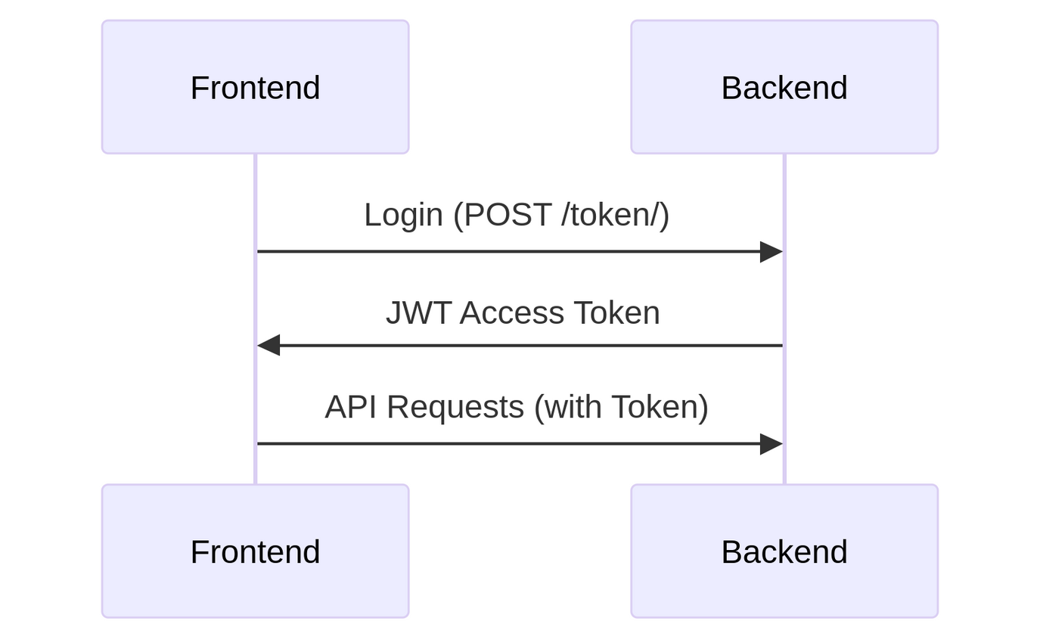
Security & Authentication
JWT Authentication Flow:

Slide 10
Challenges & Solutions
●​ Challenges:
○​ Managing many-to-many enrollments.
○​ Real-time search functionality.
●​ Solutions:
○​ Django ManyToManyField with through model.
○​ Debounced search API calls.

